Slide 1
Panel Data
Yit

Slide 2
Panel Data
What is panel data?
A mix of cross-sectional and time-series data.
Contains repeated observations on the same units over time.
Yit = Outcome of unit i at time t
Example: Unemployment by state and year*
Why use panel data / panel regression models?
Controls for unobserved, time-invariant factors (innate ability, company culture.
More data = more precision (lower standard errors)
Can model dynamics (past outcomes affecting current / future)
Reduces omitted variable bias
More realistic causal modeling (changes take place over time)

Slide 3
Example Panel Data
State | Year | Unemployment Rate
Missouri | 2005 | 4.4
Missouri | 2006 | 4.3
Missouri | 2007 | 4.1
Illinois | 2005 | 5.3
Illinois | 2006 | 5.8
Illinois | 2007 | 6.0
Kansas… | 2005… | 3.9…

Slide 4
Panel Data Models: Fixed Effects
Why use?
Control for unobserved, time-invariant factors for each unit
Assumes unit differences aren’t random
Use when data is
1) Data is in panel format
2) You suspect unobserved, time-invariant characteristics of units
3) Interest is in within-unit variation (over time)
Ex: How does worker A’s wage change from year 1 to year 2 as training hours increase
Not comparing A to B, comparing At1 to At2
FE answers “for a given worker, when they train more, does their wage rise?”, while cross-sectional OLS answers “do workers who train more have higher wages than those who train less”
Yit = B0 + Ai + B(Xit) + Uit
B0 = Intercept
Ai = Unit specific intercept modifier (each unit gets an intercept adjustment)
B = Effect of Xit on Yit within the same unit over time
Uit = Error term

Slide 5
Fixed Effects Continued
Assumptions:
Error isn’t correlated with the regressors for any time period (strict exogeneity)
No perfect collinearity (time invariant variables like gender are dropped)
Sufficient within-unit variation in X
No dynamic panel bias (if lagged Y)
Diagnostics / Tests
Hausman test for fixed vs random effects* model
Check for autocorrelation and heteroskedasticity (maybe use clustered standard errors)
Check for time invariant variables (if all are time-invariant, FE is pointless)

Slide 6
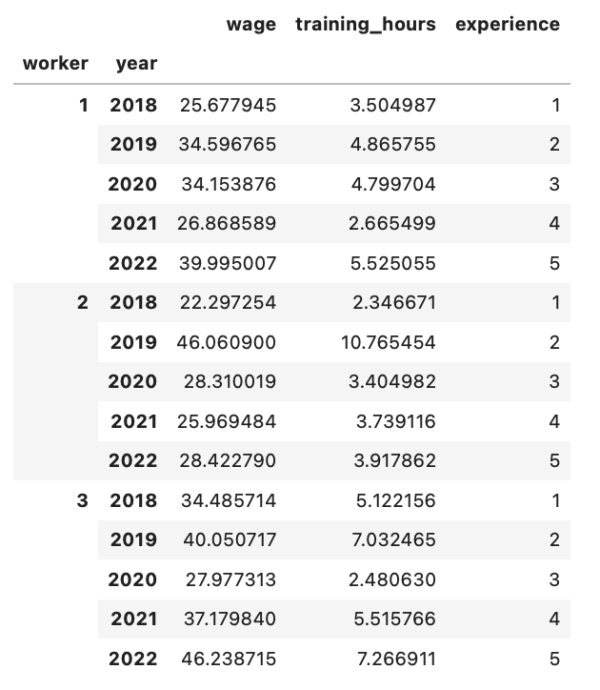
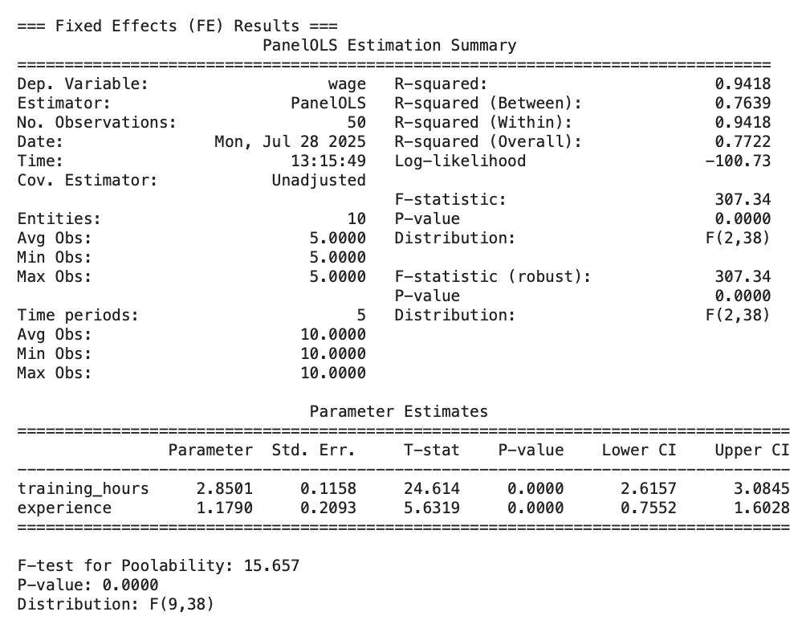
Fixed Effects Model

Slide 7
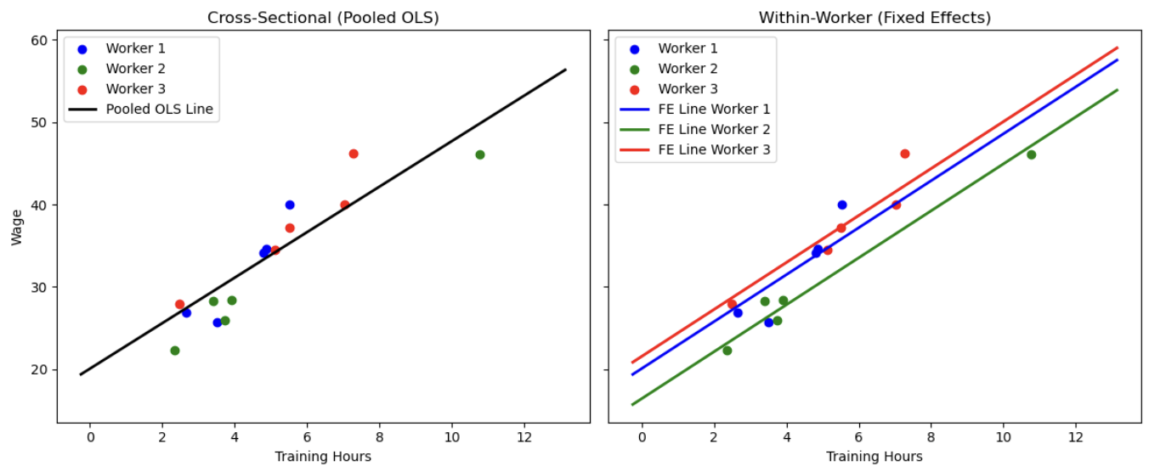

Slide 8
Panel Data Models: Random Effects
Why use?
Incorporates both within-unit variation and between-unit variation
Assumes unit differences are random
Use when
1) Data is in panel format
2) You suspect unit-specific effects (Ai) are random and uncorrelated with Xit
3) You want to leverage both within-unit changes and cross-unit differences for efficiency
Ex: Do workers who train more (both over time and compared to other workers) tend to earn higher wages, assuming that unobserved worker ability is random and unrelated to training?
RE answers: “Across workers and over time, does training correlate with higher wages, assuming differences in worker ability are random and uncorrelated with training?
Yit = B0 + Bk(Xkit) + Ai + Uit
B0 = Overall intercept
B = Slope (effect of Xit on Yit)
Ai = Random effect for unit i
Uit = Error term

Slide 9
Random Effects Continued
Assumptions:
Unit specific random effect Ai is not correlated with Xit
No perfect multicollinearity
No heteroskedasticity or autocorrelation
Random effects are normally distributed
Diagnostics / Tests
Hausman test for fixed vs random effects* model
Breusch-Pagan LM test for pooled OLS vs RE
Check for autocorrelation and heteroskedasticity (maybe use clustered standard errors)
Check for time invariant variables (if all are time-invariant, FE is pointless)

Slide 10
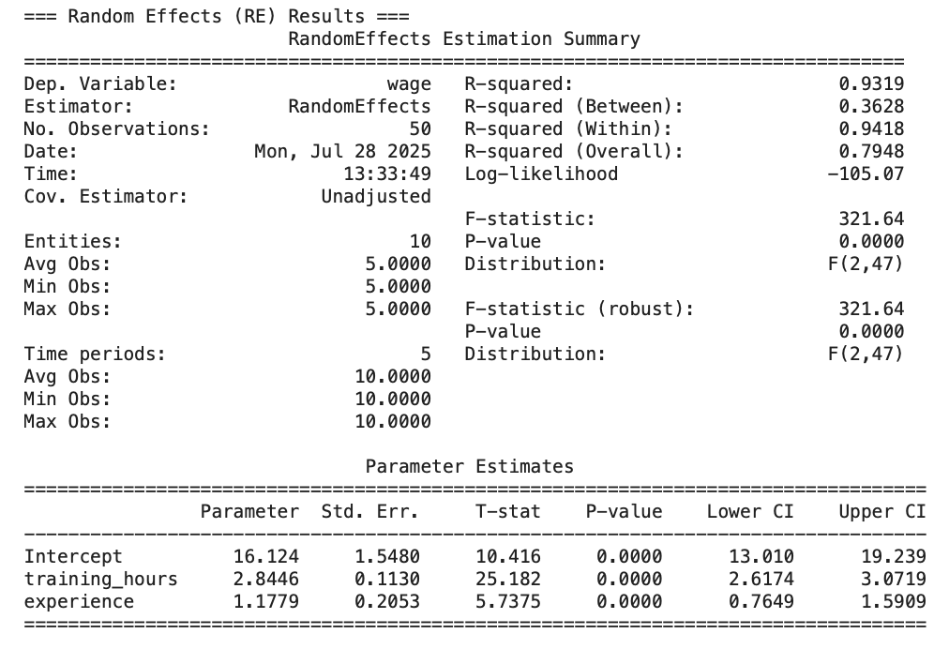
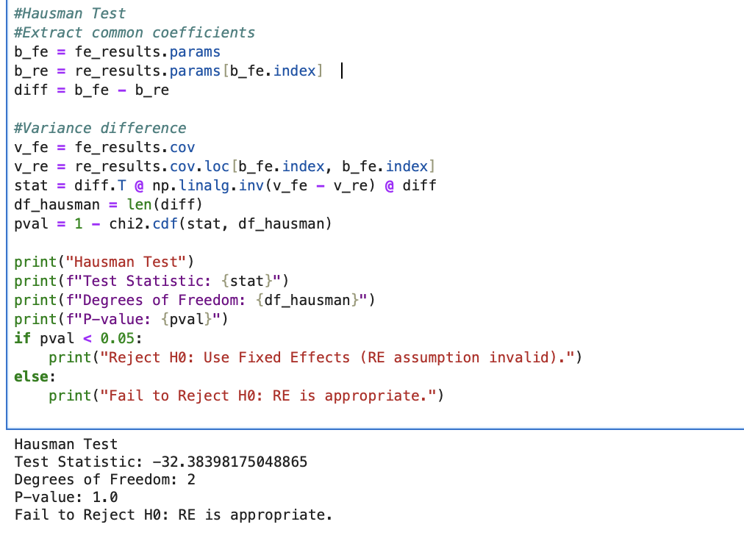
Random Effects

Slide 11
